Slide 1
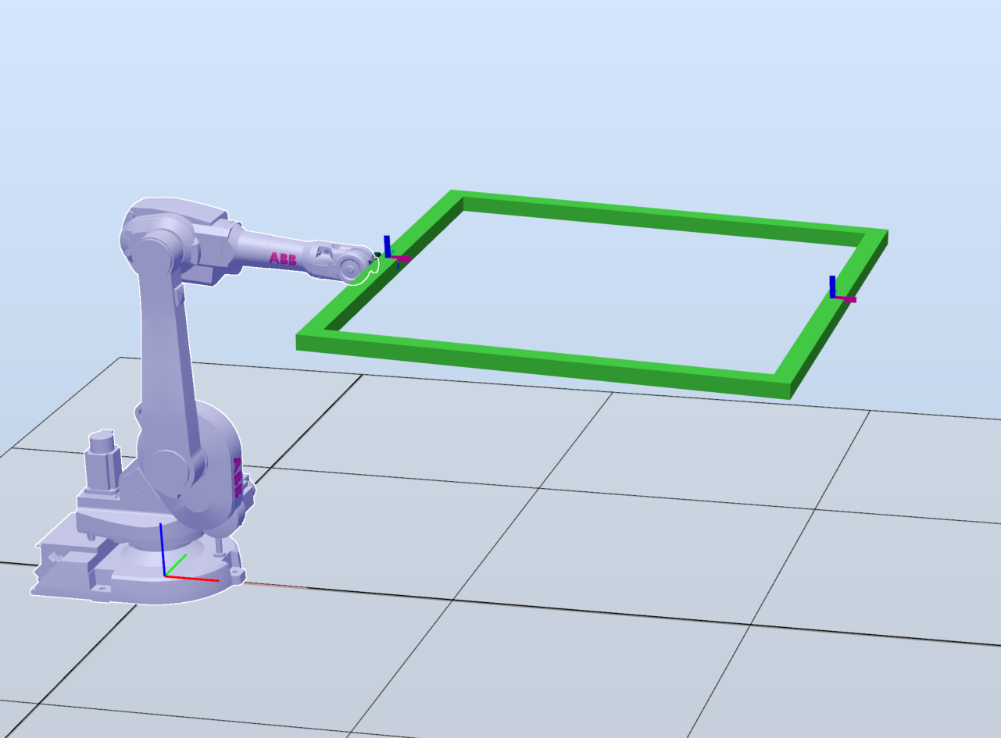
Robot and tool setup
Rx
Ry

Slide 2
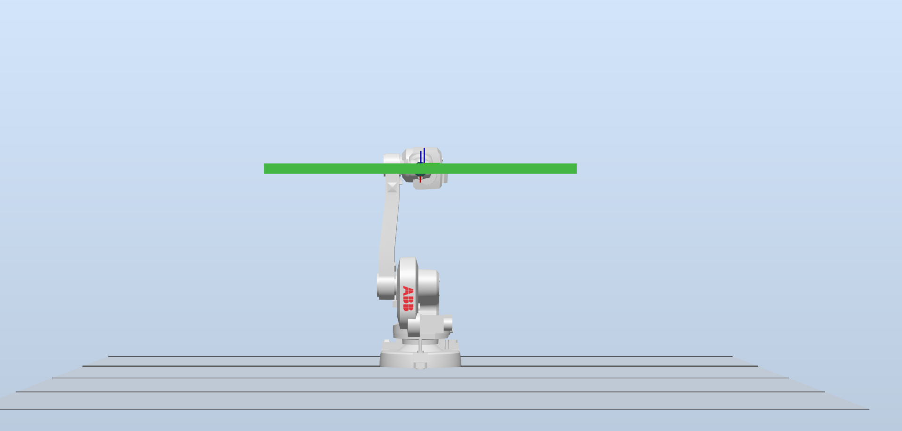
Rx Extents
-85°
+85°

Slide 3
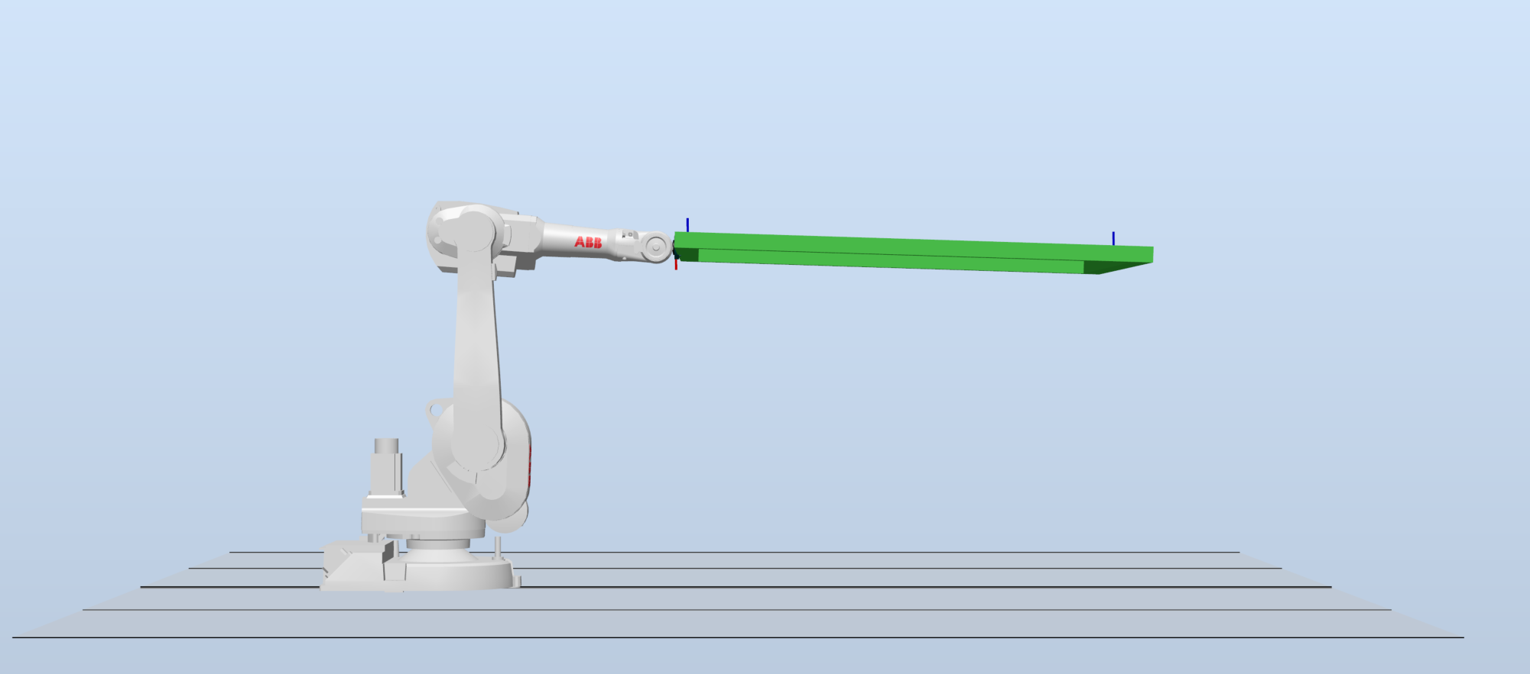
Ry extents
+45°
-45°

